Slide 1

BUSINESS ANALYSIS Reporting and Storytelling

Slide 2
DATA STORYTELLING
What is data storytelling?
“Data storytelling is the ability to effectively communicate insights from a dataset using narratives and visualizations. It can be used to put data insights into context for and inspire action from your audience.”
Why use the data storytelling method?
Brain’s preference for stories over data
Stimulates brain on multiple levels: language comprehension, emotional response, empathy
Three components of data storytelling
“Data: Thorough analysis of accurate, complete data serves as the foundation of your data story. Analyzing data using descriptive, diagnostic, predictive, and prescriptive analysis can enable you to understand its full picture.
Narrative: A verbal or written narrative, also called a storyline, is used to communicate insights gleaned from data, the context surrounding it, and actions you recommend and aim to inspire in your audience.
Visualizations: Visual representations of your data and narrative can be useful for communicating its story clearly and memorably. These can be charts, graphs, diagrams, pictures, or videos.”
Source: Harvard Business School; https://online.hbs.edu/blog/post/data-storytelling

Slide 3
CRAFTING A GOOD STORY
Example:
As a business analyst you notice that a company’s recent decline in sales has been driven by customers of all genders between the ages of 14 and 23. The drop was caused by a viral social media post highlighting the company’s negative impact on the environment
Characters: Identify players and stakeholders which in this case include customers between the ages of 14 and 23, environmentally conscious consumers, and your internal team
Setting: Set the scene and explain the drop in sales driven by customers of all genders ages 14 to 23. Use a data visualization to show the decline across audience types and highlight the largest drop in young users.
Conflict: Describe the root issue i.e., how a viral social media post highlighted your company’s negative impact on the environment causing young customers to stop using your product. You may incorporate other related research on the trend and use visualization tools where required
Resolution: Propose your solution. Based on this data, you may present long-term goal of sustainable manufacturing practices and tailor marketing and public relations efforts towards this goal
Source: Harvard Business School; https://online.hbs.edu/blog/post/data-storytelling

Slide 4
USING DATA VISUALIZATION AND STORYTELLING TOGETHER
Data visualization helps
Communicate complex information
Transform large amounts of data into something simpler and digestible
Reveal patterns, trends, and findings from an unbiased viewpoint
Provide context, interpret results, and articulate insights
Streamline data so your audience can process information
Improve audience engagement
Video: Largest Economies Ranked: Data from 1580 to 2025
Source: Microsoft; https://www.microsoft.com/en-my/power-platform/products/power-bi/topics/data-storytelling

Slide 5
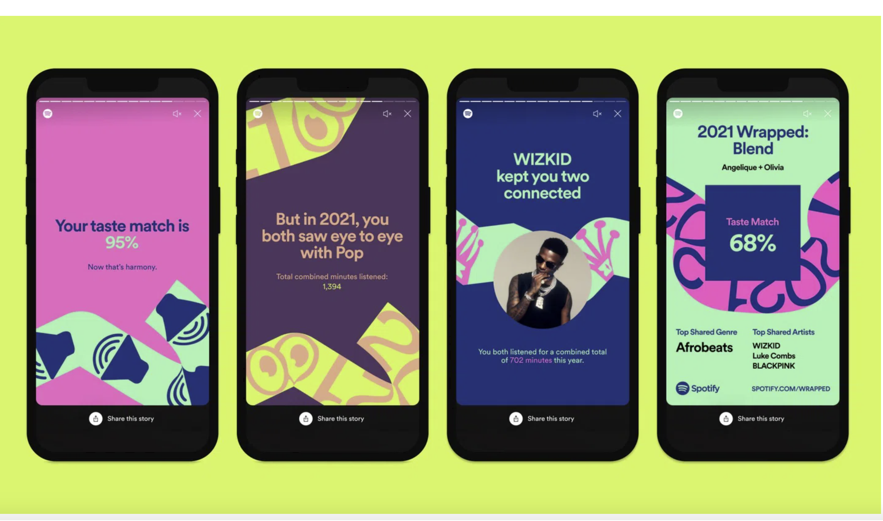
REAL WORLD CASES
Spotify Wrapped Annual Campaign
Transforms each user's listening data from the past year into and engaging visual narrative.
Users receive a story that reflects their identity, habits, and tastes.
Features like "Music Personality" archetypes and comparisons to broader global trends make the data relatable and surprising.
Video: Introduction to Tableau
Source: GrowthBI; https://www.growthbi.com.au/post/top-data-storytelling-examples-to-inspire-your-business-strategy

Slide 6
USING DATA DASHBOARDS AND STORYTELLING TOGETHER
Data dashboards are used for information management and business intelligence (BI) and organize and display information in an easy-to-understand format in a single location.
Benefits of data dashboards:
Provide a clear view of trends and patterns to reinforce the story’s main points.
Highlight key performance indicators and metrics that directly support the narrative.
Allow audience to interact with data and explore insights that add depth to the story.
Offer context and comparison, so the "why" behind the numbers is easier to understand.
Source: Microsoft; https://www.microsoft.com/en-my/power-platform/products/power-bi/topics/data-storytelling

Slide 7
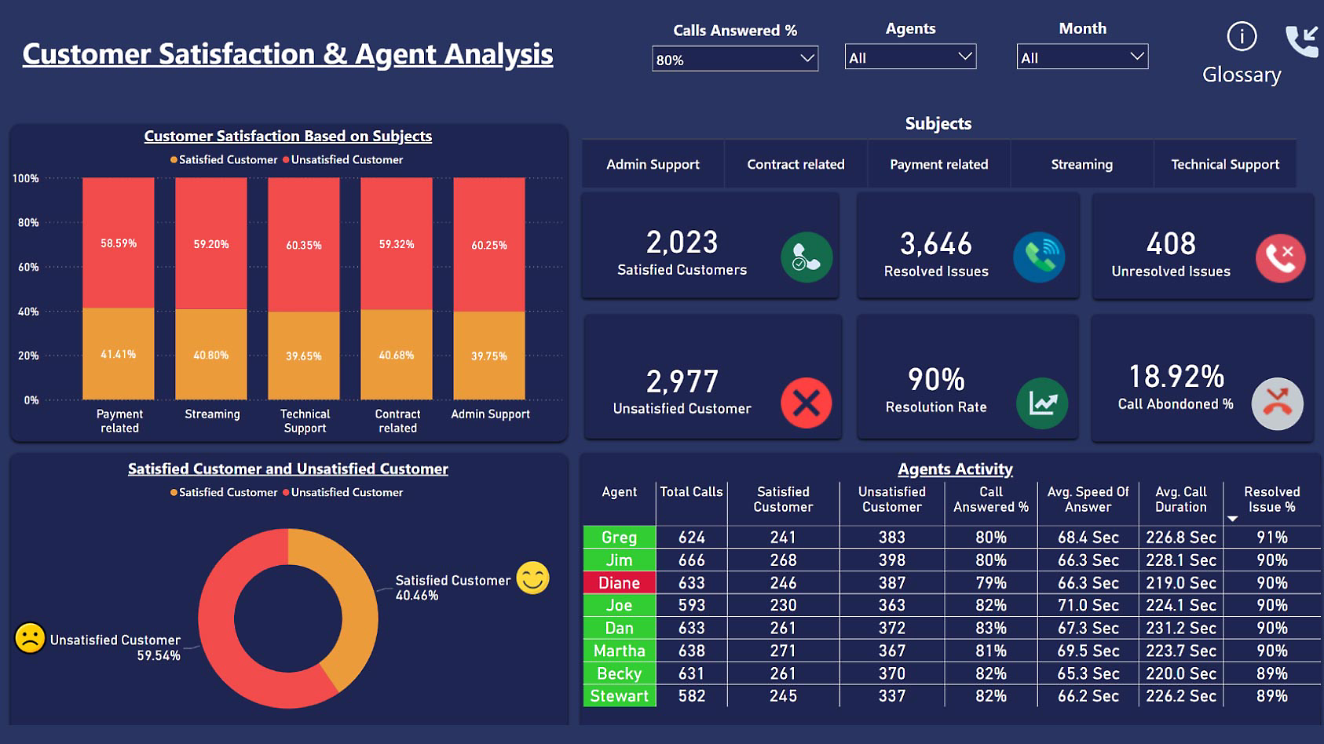
REAL WORLD CASES
Call center analysis of customer satisfaction
Percentage of satisfied and unsatisfied customers
Total number of satisfied and unsatisfied customers
Video: Introduction to Power BI
Source: Microsoft; https://www.microsoft.com/en-my/power-platform/products/power-bi/topics/data-storytelling

Slide 8
EXECUTIVE SUMMARIES
An executive summary
Is a concise overview of a larger document which is located at the beginning designed to capture a decision-maker's attention
Provides a succinct snapshot of an entire proposal or document, e.g., a presentation, a case study, research
If part of business report, concisely presents key points of the report to e.g., investors, funders, or other interested parties
Source: Coursera; https://www.coursera.org/articles/executive-summary

Slide 9
EXECUTIVE SUMMARIES OF BUSINESS REPORTS
What executive summary of a business report may include:
Business description: Overview of the business idea, its nature, and its industry or market.
Problem statement: Business challenge or need and its immediate and long-term significance and impact.
Solution: Solution or product that addresses the identified problem or need.
Target market: Description of target audience, including its size, characteristics, and demographics and the opportunity it represents
Competitive advantage: The unique selling points or competitive advantages of your business, distinguishing it from competitors
Business model: A high-level overview of a business’ strategies, pricing strategy, distribution channels, and any notable
Financial summary: Financial projections, including estimated revenue, expenses, profits (doing so offers investors and stakeholders a sense of the business viability from a financial standpoint)
Expertise: Highlight key team members, emphasizing their relevant experience, skills, and expertise
Funding requirements: Amount required, how it will be used and expected return on investment
Source: Coursera; https://www.coursera.org/articles/executive-summary
Growth grid; https://growth-grid.ai/blog/executive-summary-examples/

Slide 10
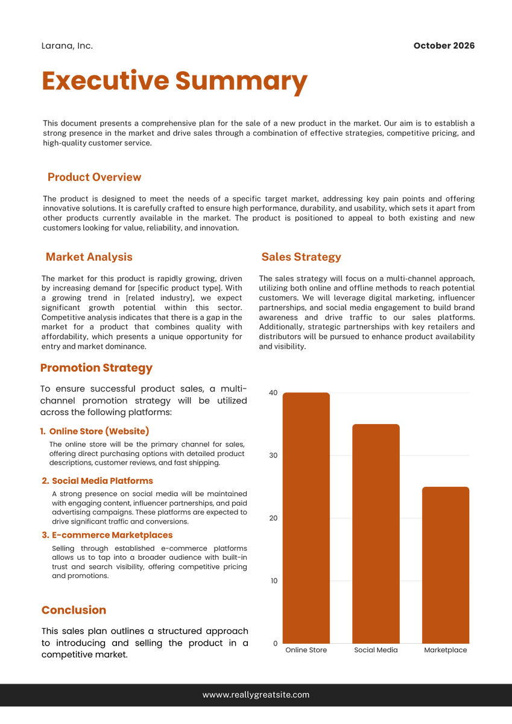
EXECUTIVE SUMMARIES TEMPLATES
Executive summary of a business plan for sale of a new product
Includes product overview, market analysis, promotion strategy, sales strategy
Source: TEMPLATE.NET; https://www.template.net/business/word-templates/best-executive-summary-samples/

Slide 11
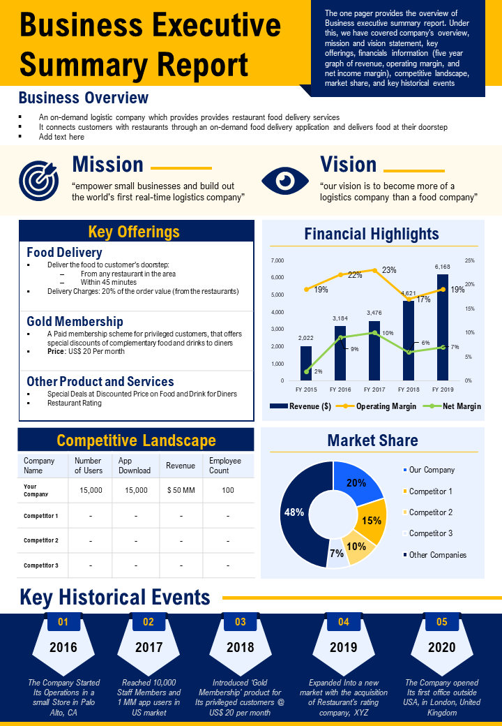
EXECUTIVE SUMMARIES EXAMPLES
Executive summary of a report providing information of a business
Includes business overview, mission and vision key offerings, financial highlights, market share analysis, key historical events, and competitive landscape showcasing revenue generation, number of users, and employees
Source: Slide Team; https://www.slideteam.net/blog/top-10-executive-summary-report-templates-with-samples-and-examples

Slide 12
ACTIVITY: DESIGNING A DASHBOARD
Generate business data using the hyperlink TrumpExcel
Format an Excel sheet for a dashboard presentation
Generate a pivot table using the data downloaded
Identify a potential audience for that data (management, investors, customers etc.)
Pick out the statistics, data that you would want an audience to visualize
Create a dashboard for the potential audience
Make the dashboard dynamic with a slicer
Note: Standardization of data is important; use e.g., the “Filter” command in Excel to standardize fields
Source for data: TrumpExcel; available at https://trumpexcel.com/excel-sample-data/?_thumbnail_id=46825#Create-Your-Own-Sample-Dataset-in-Excel

Slide 13
ESSENTIAL READINGS
Coursera: “The art of writing a powerful executive summary”, available at https://www.coursera.org/articles/executive-summary
GrowthBI: “Top data story-telling examples”, available at https://www.growthbi.com.au/post/top-data-storytelling-examples-to-inspire-your-business-strategy
growth grid: “8 Executive summary examples”, available at https://growth-grid.ai/blog/executive-summary-examples/
Harvard Business School: “Data story-telling”, available at https://online.hbs.edu/blog/post/data-storytelling
Microsoft: “What is data storytelling”, available at https://www.microsoft.com/en-my/power-platform/products/power-bi/topics/data-storytelling
Slide Team: “Top 10 Executive summary report templates”, available at https://www.slideteam.net/blog/top-10-executive-summary-report-templates-with-samples-and-examples
TEMPLATE.NET: “22+ Best executive summary templates”, available at https://www.template.net/business/word-templates/best-executive-summary-samples/
Trump Excel: “Excel sample data download”, available at https://trumpexcel.com/excel-sample-data/?_thumbnail_id=46825#Create-Your-Own-Sample-Dataset-in-Excel

Slide 14
REFERENCE BOOKS OPTIONS
BUSINESS ANALYSIS BODY OF KNOWLEDGE (BABOK); IIBA Bookstore: https://www.iiba.org/career-resources/a-business-analysis-professionals-foundation-for-success/babok/
BUSINESS ANALYSIS (Fourth Edition) by Debra Paul (Author), James Cadle (Author), Malcolm Eva (Author), Craig Rollason (Author), Jonathan Hunsley (Author)
BUSINESS ANALYSIS TECHNIQUES: 123 ESSENTIAL TOOLS FOR SUCCESS (3RD Edition) by James Cadle (Author), Debra Paul (Author), Jonathan Hunsley (Author), Adrian Reed (Author)

